Slide 1

STUDENT INTERNSHIP MANAGEMENT SYSTEM
Page: 1

Slide 2

TEAM - 04
ANUSHA POREDDY
SHASHANKAR CHENNU
PARIMALLA POKURI
SAI KRISHNA GADDE
MANIKANTA ARUMILLI
Mentor & Client
Dr. CHANDRA MOULI MADHAV KOTTETI
Page: 2

Slide 3
Agenda
Why this Application
Introduction to the Application
Languages
Tools
Conclusion
Page: 3

Slide 4
WHY SIMS…?
The Student internship management system (SIMS) is a fundamental fragment of communication between students, educational institutions and Companies (S-E-A).
Internships are beneficial because they improve your professional aptitude, boost your character, and open up more opportunities.
By investing in internships, you'll give yourself the broadest spectrum of opportunity when seeking and applying for a job after college.
Presenter: Shashank Chennu
Page: 4

Slide 5
Introduction to Application
Student Internship Management System is a Web-based application that serves as a link between students and employers.
Students can look for employment and submit applications.
Companies can assess the student applications, accept or reject the application and then recruit the applicants.
There is an Administrator who has the authority to prevent the bogus data from being generated by either students or businesses.
Presenter: Shashank Chennu
Page: 5

Slide 6
Languages used
Front End: Hyper Text Markup Language(HTML), Cascading Style Sheet(CSS), Java Script(JS)
Back End Technology: Node.js, Express.js
Database: MongoDB and Robot 3T
Presenter: Shashank Chennu
Page: 6

Slide 7
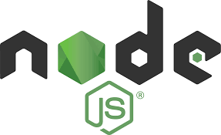
What is Node.js…?
Node.js is an open source, cross-platform runtime environment for developing server-side and networking applications.
Node.js also provides a rich library of various JavaScript modules which simplifies the development of web applications using Node.js to a great extent
Node.js= Runtime Environment + JavaScript Library
Presenter: Shashank Chennu
Page: 7

Slide 8
Why Node.js…?
Node. js is primarily used for non-blocking, event-driven servers, due to its single-threaded nature.
It's used for traditional web sites and back-end API services.
providing serverless architecture and real-time communication support
Presenter: Shashank Chennu
Page: 8

Slide 9
Where to use Node.js..?
Following are the areas where Node.js is proving itself as a perfect technology partner:
I/O bound Applications
Data Streaming Application
Data Intensive Real-time Applications (DIRT)
JSON APIs based Applications
Presenter: Parimalla pokuri
Page: 9

Slide 10
Node.js Architecture
Node.js uses the “Single Threaded Event Loop” architecture
Used to handle multiple concurrent clients.
Node.js Processing Model is based on the JavaScript event-based model along with the JavaScript callback mechanism.
Presenter: Parimalla Pokuri
Page: 10

Slide 11
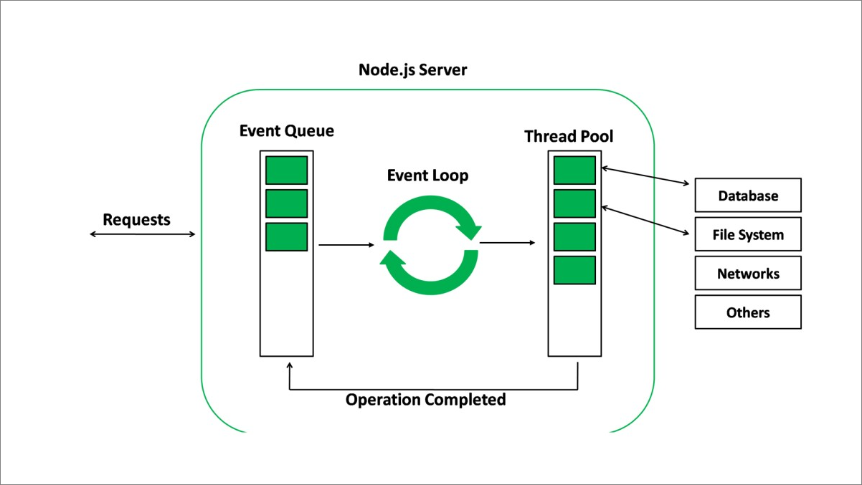
Cont…
Presenter: Parimalla Pokuri
Page: 11

Slide 12
Parts of the Node.js Architecture:
Requests
Node.js Server
Event Queue
Thread Pool
Event Loop
External Resources
Presenter: Parimalla Pokuri
Page: 12

Slide 13
Key features:
Asynchronous and Event Driven.
Very Fast
Single Threaded but Highly Scalable
No Buffering
Presenter: Parimalla Pokuri
Page: 13

Slide 14
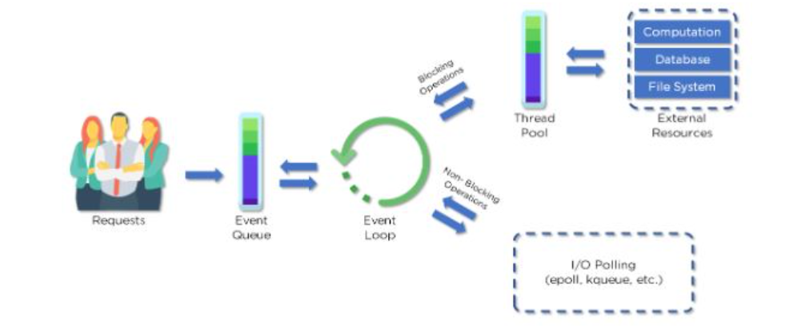
Workflow of Node.js
Fig: Node.js Architecture Workflow
Presenter: Sai Krishna Gadee
Page: 14

Slide 15
Cont…
Clients send requests to the webserver to interact with the web application. Requests can be non-blocking or blocking:
Querying for data
Deleting Data
Updating Data.
Presenter: Sai Krishna Gadee
Page: 15

Slide 16
Cont…
Node.js retrieves the incoming requests and adds those requests to the Event Queue.
The requests are then passed one-by-one through the Event Loop. It checks if the requests are simple enough to not require any external resources.
Event Loop processes simple requests (non-blocking operations), such as I/O Polling, and returns the responses to the corresponding client
Presenter: Sai Krishna Gadee
Page: 16

Slide 17
Cont…
A single thread from the Thread Pool is assigned to a single complex request.
This thread is responsible for completing a particular blocking request by accessing the external resources, such as compute, database, file system, etc.
Once, the task is carried out completely, the response is sent to the Event Loop that in turn sends that response back to the Client.
Presenter: Sai Krishna Gadee
Page: 17

Slide 18

MongoDB
what is MongoDB..?
why MongoDB..?
what is JSON..?
Architecture of MongoDB..?
Presenter: Anusha Poreddy
Page: 18

Slide 19
What & Why MongoDB..?
MongoDB is a Source available, Cross Platform, Document Oriented Database System with scalability and flexibility that we want with querying and indexing that we need.
As I said MongoDb is a document database, being a document database it makes users very easy to store structured or unstructured data.
For storing documents it uses JSON like format.
Presenter: Anusha Poreddy
Page: 19

Slide 20

What is JSON…?
JSON stands for JavaScript Object Notation. It is a lightweight format for storing and transporting data.
JSON is often used when data is sent from a server to a web page.
JSON is "self-describing" and easy to understand.
Presenter: Anusha Poreddy
Page: 20

Slide 21
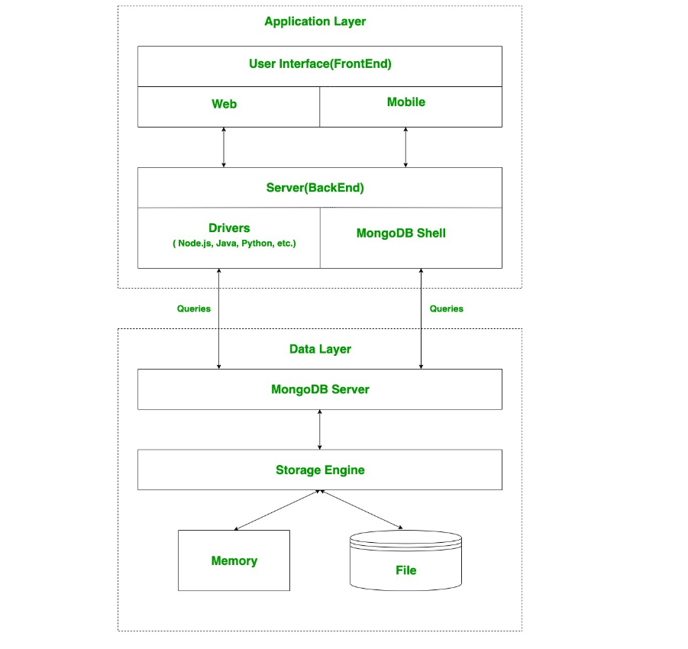
MongoDB Architecture
Two layers in the architecture:
Application Layer.
Data Layer.
Presenter: Anusha Poreddy
Page: 21

Slide 22
Cont…
Application Layer:
This layer is also known as Final Abstraction Layer. It has two parts first is a Frontend(User Interface), second is backend(Server).
In frontend, user uses MongoDB with the help of web or mobile.
The web and mobile includes web page, mobile application, android default application and IOS application etc..,
In Backend, server is present which is used to perform serverside logic and also contain drivers and mongodb shell to interact with mongodb server with the help of queries.
Presenter: Anusha Poreddy
Page: 22

Slide 23
Cont…
Data layer:
These queries are sent to the mongodb server present in the data layer.
The server receives the queries and passes to the Storage Engine.
Mongodb server itself does not directly read or write the data to the files or disk or memory.
After passing received queries to storage engine, Storage engine is responsible to read or write the data to the files or disk or memory basically it manages the data.
Presenter: Anusha Poreddy
Page: 23

Slide 24

what is Robot 3t ?
Robot 3T is a lightweight, open-source, shell centric, cross-platform graphical user interface tool for managing MongoDB workloads.
Robot 3T gives you the ability to create databases, collections, add users, documents, execute one-time queries with auto-completion, and visualize results from a GUI interface.
Presenter: Manikanta Arumilli
Page: 24

Slide 25
what is robot 3t in mongodb?
Users can interact with the data bricks using the visual indicators that save time than using a command-line shell.
Robot 3T is supported by JSON and is highly specific to be used for MongoDB administrative tools to perform GUI-based tasks such as users can view, edit and delete documents.
Presenter: Manikanta Arumilli
Page: 25

Slide 26
why Robot 3t?
Robot 3T can be justified with the fact that it is a free machine-friendly software build to make use of the small number of resources available on a machine.
It is a highly curated and recommended tool for various large-scale projects that need a high success ratio for generating prime output.
Presenter: Manikanta Arumilli
Page: 26

Slide 27
key features of Robot 3t:
1.Real Autocompletion:
Apart from just analyzing the semantics of the code, RoboMongo also executes the code in the internal JavaScript Virtual Machine that allows users to get runtime autocompletion and saves time.
2) Well Designed :
RoboMongo is designed keeping in mind to ease the workflow and simplify the process of viewing, editing, updating the MongoDB Database. It comes with a user-friendly user interface and is a good start for beginners to learn about MongoDB shell.
Presenter: Manikanta Arumilli
Page: 27

Slide 28
key features of Robot 3t:
3) Open-source:
Robo 3T is a licensed open source project that makes it free to use for the public and has huge community support that adds many custom features
4) Fully Asynchronous :
RoboMongo is designed keeping in mind that all the operations performed on MongoDB are done asynchronously to deliver a non-blocking UI. This does not block the main application thread.
Presenter: Manikanta Arumilli
Page: 28

Slide 29
TEAM - 04
ANUSHA POREDDY
SHASHANKAR CHENNU
PARIMALLA POKURI
SAI KRISHNA GADDE
MANIKANTA ARUMILLI
Mentor & Client
Dr. CHANDRA MOULI MADHAV KOTTETI

Slide 30
STUDENT INTERNSHIP MANAGEMENT SYSTEM

Slide 31

Thank You

